Slide 1
SIMPLE LINEAR REGRESSION
By- Vandana Kate

Slide 2
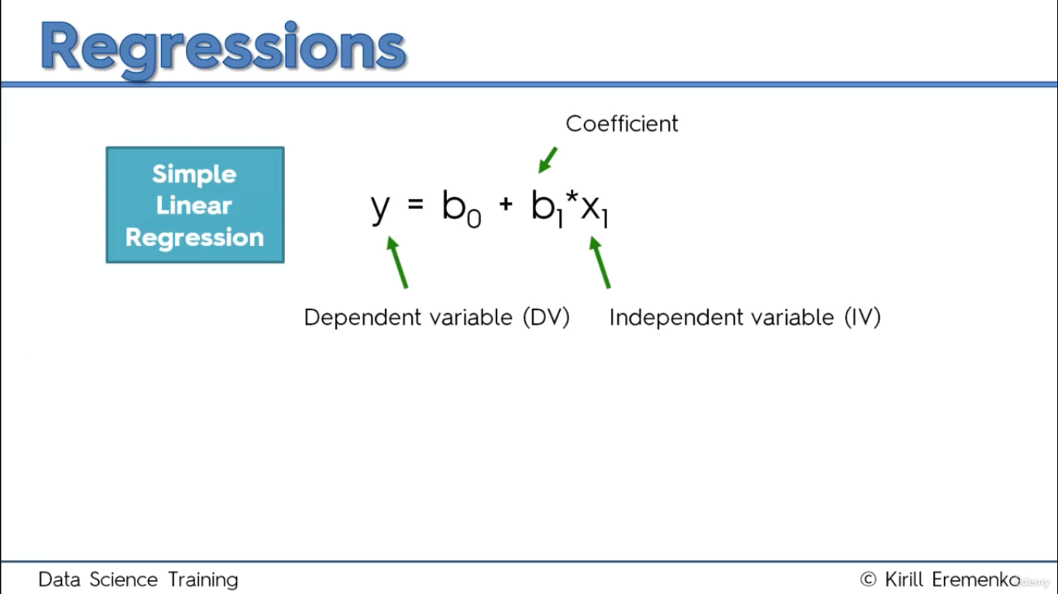

Slide 3
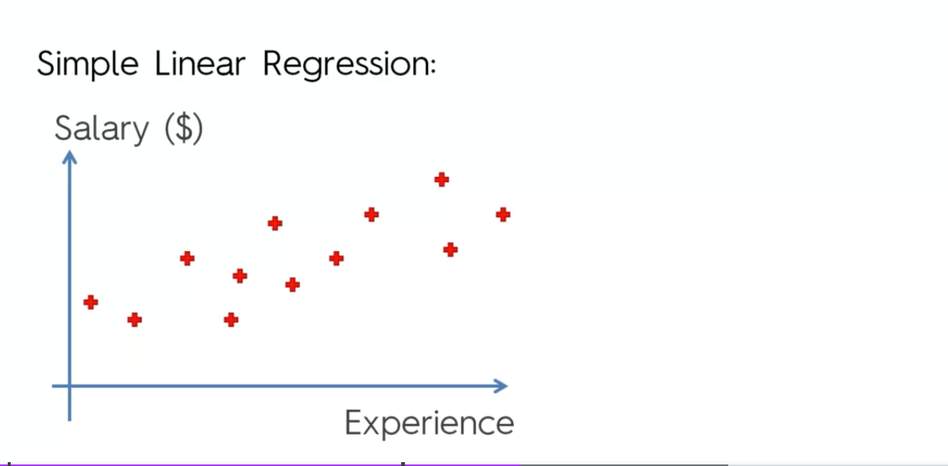

Slide 4
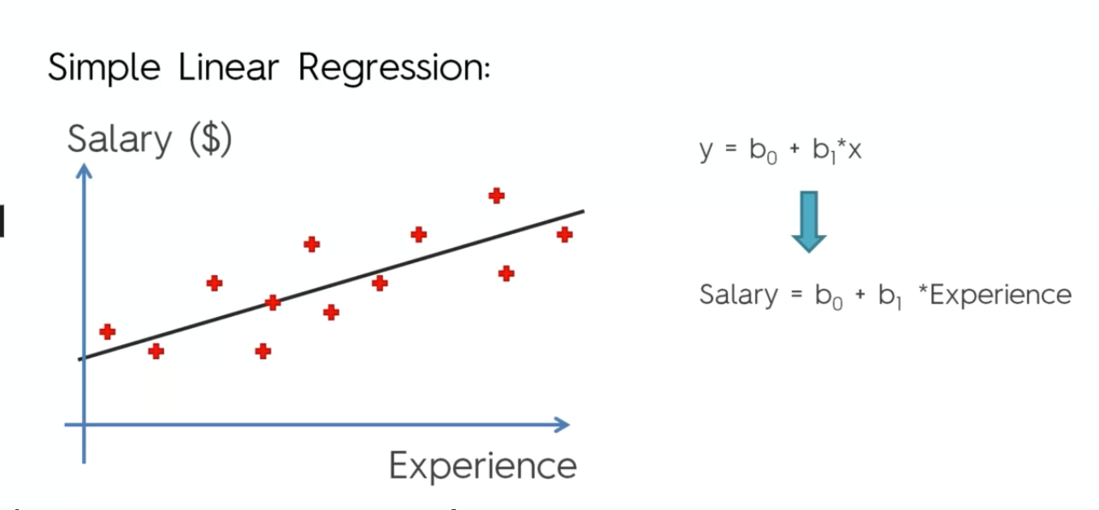
SLOPE EQUATION

Slide 5
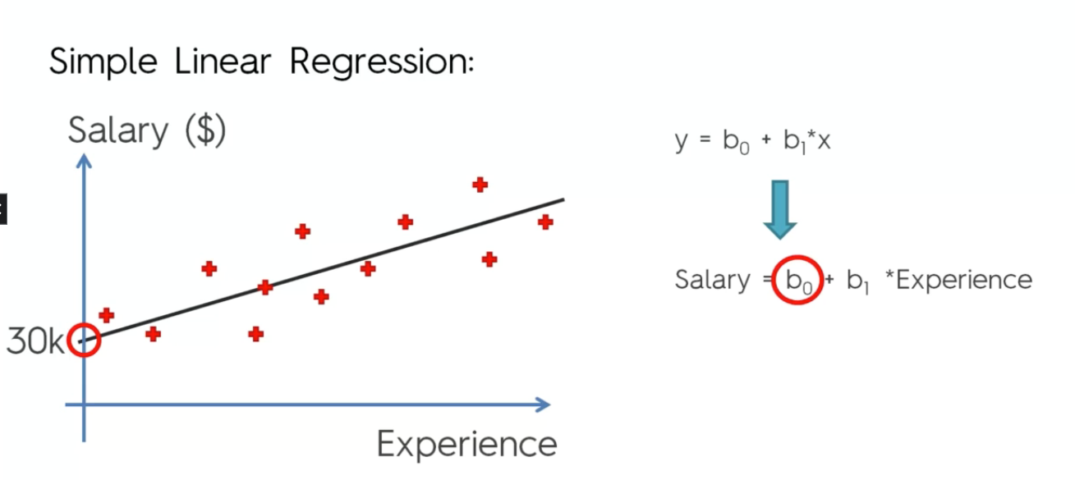
INTERCEPT

Slide 6
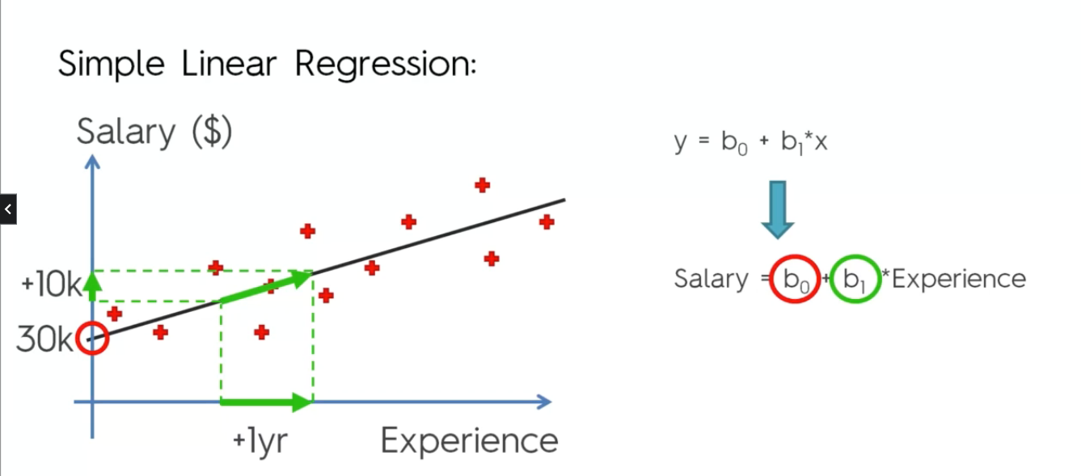
SLOPE INCREASES WITH EXPERIENCE

Slide 7
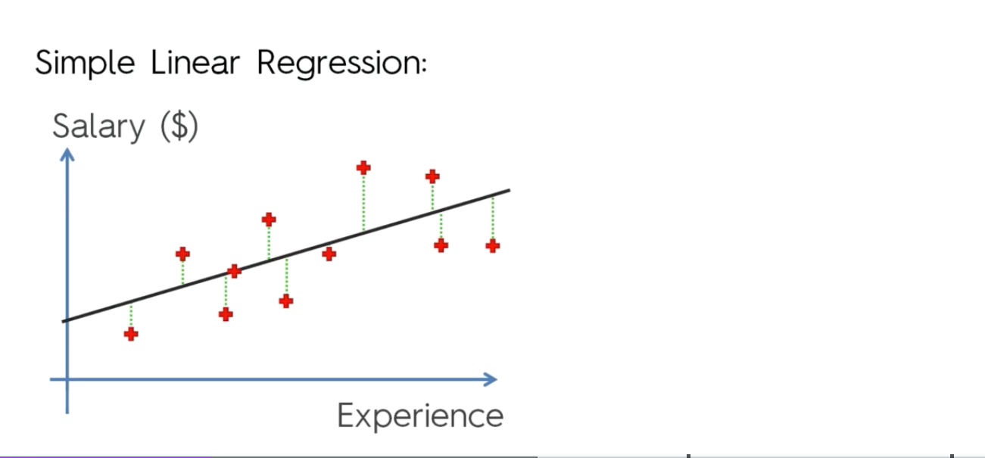
DRAW VERTICLE LINES TO UNDERSTAND HOW WRONG WERE THE PREDICTIONS

Slide 8
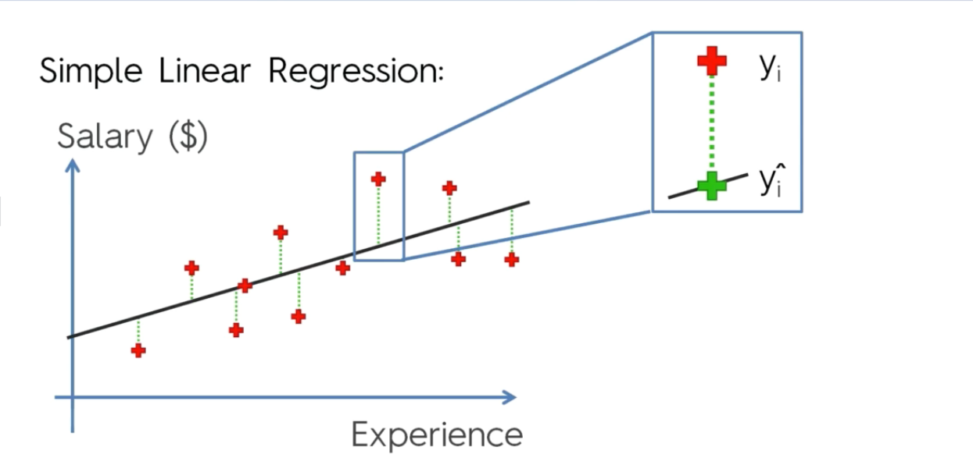
Actual and Predicted Values

Slide 9
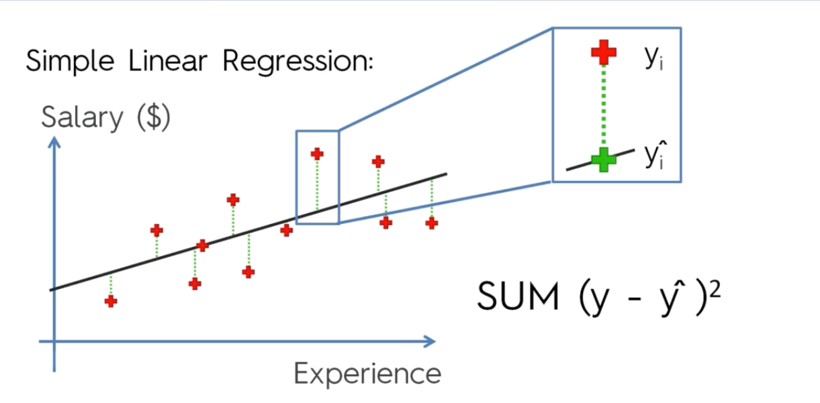

Slide 10
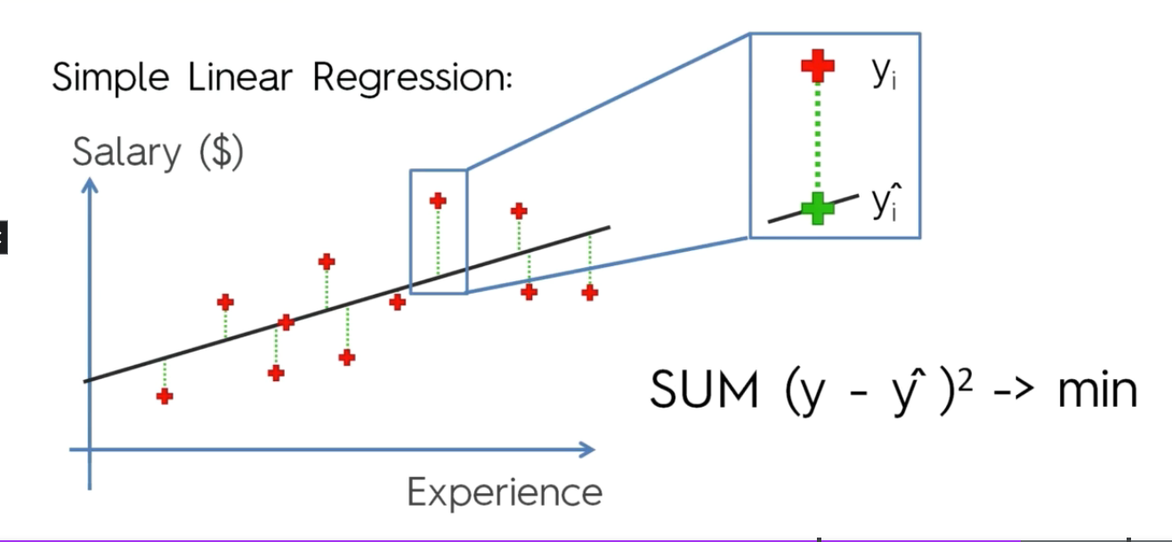
Best Fit Line will one with minimal squared error

Slide 14
Optimization Algorithm Used
Gradient descent (GD) is an iterative first-order optimisation algorithm used to find a local minimum/maximum of a given function. This method is commonly used in machine learning (ML) and deep learning(DL) to minimise a cost/loss function (e.g. in a linear regression).

Slide 15


